Slide 1
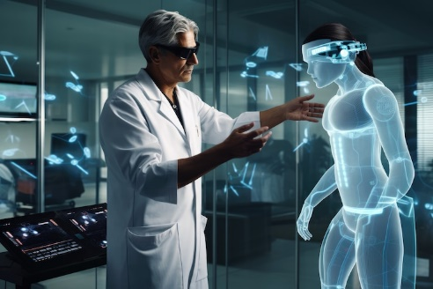
Artificial Intelligence in Healthcare
Transformative Solutions and Innovations

Slide 2


Introduction
Artificial Intelligence (AI) is revolutionizing the healthcare industry by enhancing diagnostics, treatments, and patient care. This presentation explores the applications of AI in healthcare, highlighting its impact on disease diagnosis, drug discovery, robotic surgery, and personalized medicine.
+

Slide 3

Table of contents
Introduction to AI
AI in Healthcare
Leading Companies in AI Healthcare
Applications of AI in Healthcare
Disease Identification and Diagnosis
Personalized Treatment and Behavioral Modification
Drug Discovery and Manufacturing
Robotic Surgery
Clinical Trial Research
Automating Repetitive Tasks
Treatment Design

Slide 4

Introduction to AI
AI involves simulating human cognitive functions such as learning and decision-making.
It has applications across various domains including healthcare, enhancing efficiency and innovation.

Slide 5
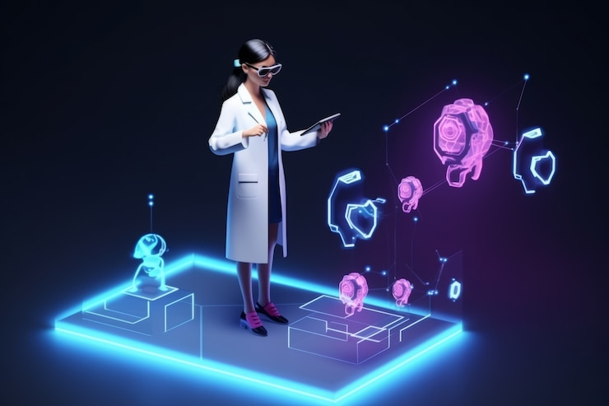
AI in Healthcare
Transforming how surgeries and medical treatments are performed.
Revolutionizing disease diagnosis and patient management through advanced analytics.

Slide 6

Leading Companies in AI Healthcare
iCarbonX: Personalized wellness recommendations through health data analysis.
Babylon Health: AI for telemedicine and virtual healthcare services.
Yitu Technology: Medical imaging solutions for accurate disease diagnosis.
CARMAT: AI-driven artificial hearts for improved patient outcomes.

Slide 7

Applications of AI in Healthcare
Disease Identification and Diagnosis: Enhancing accuracy and speed.
Personalized Treatment: Tailoring healthcare to individual needs.
Drug Discovery: Accelerating new medicine development.
Robotic Surgery: Improving surgical precision.
Clinical Trials: Streamlining with AI data analysis.
Task Automation: Reducing workload and errors.
Treatment Design: Crafting personalized care plans.

Slide 8
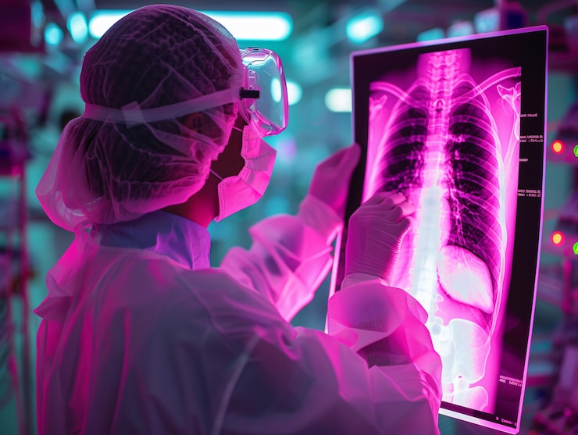
Disease Identification and Diagnosis
AI algorithms analyze symptoms and medical data to transform disease detection.
Improved accuracy in diagnosing complex conditions like heart disease and lung cancer.

Slide 9
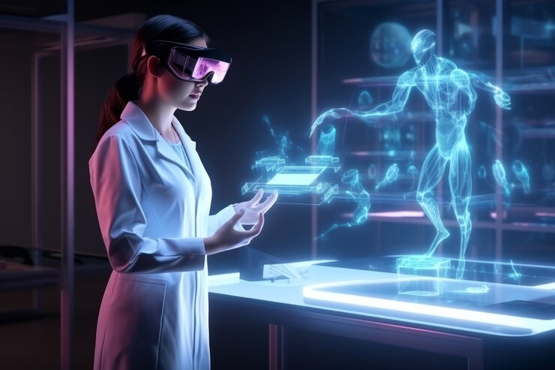
Personalized Treatment and Behavioral Modification
Customized medical treatments leveraging predictive analytics. Use of micro biosensors for remote monitoring and optimized health outcomes.

Slide 10
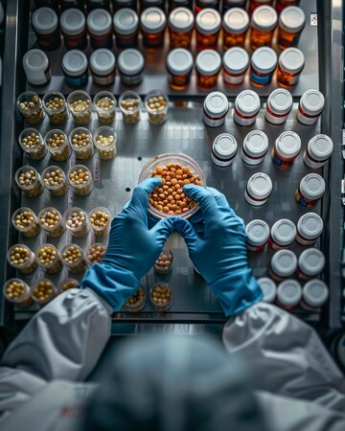
Drug Discovery and Manufacturing
AI accelerates drug discovery using deep learning and predictive algorithms. Leading companies are leveraging AI for innovative solutions.

Slide 11
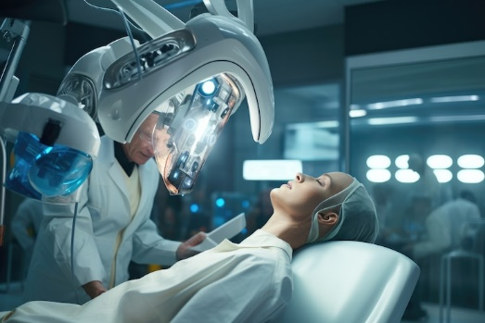
Robotic Surgery
Robotic systems, like the da Vinci robot, enhance surgical precision.
Expectation of advancements leading to fully autonomous operations.

Slide 12

Clinical Trial Research
AI optimizes study designs and enhances participant safety through monitoring.
Real-time insights help in identifying potential risks.

Slide 13

Automating Repetitive Tasks
AI automates tasks like analysis of medical tests and data entry.
Speeds up processes in fields like cardiology and radiology.

Slide 14

Treatment Design
AI analyzes patient records and research to recommend tailored care plans. Improves efficiency in healthcare management.

Slide 15

Conclusion
AI is set to significantly transform healthcare by improving treatment outcomes and efficiency. Its potential for innovation in surgeries, patient monitoring, and care design promises a future where healthcare is more accessible and effective.

Slide 16
Thank you!
Do you have any questions?
youremail@email.com
+91 620 421 838
www.yourwebsite.com
@yourusername

